Slide 1
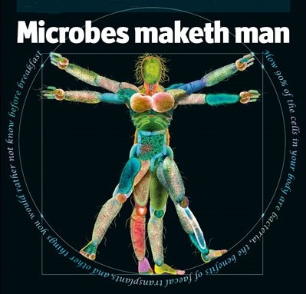
Gut microbiome signatures of Colorectal Cancer
Mani Arumugam, PhD
Associate Professor

Slide 2
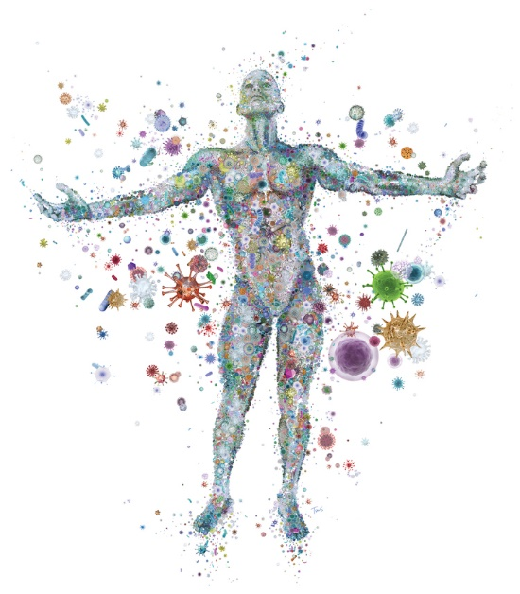
What is human microbiota
We are a walking zoo
Trillions of microbes in our body
1-2 kgs of microbes in our gut

Slide 3
Gut microbiota are essential
Immune system & defense
gut microbiota and immune system shape each other
crucial for early development
stimulate the immune system
act as protective barrier against pathogenic bacteria
Metabolism
convert dietary polysaccharides to energy (short-chain fatty acids)
synthesize vitamins

Slide 4
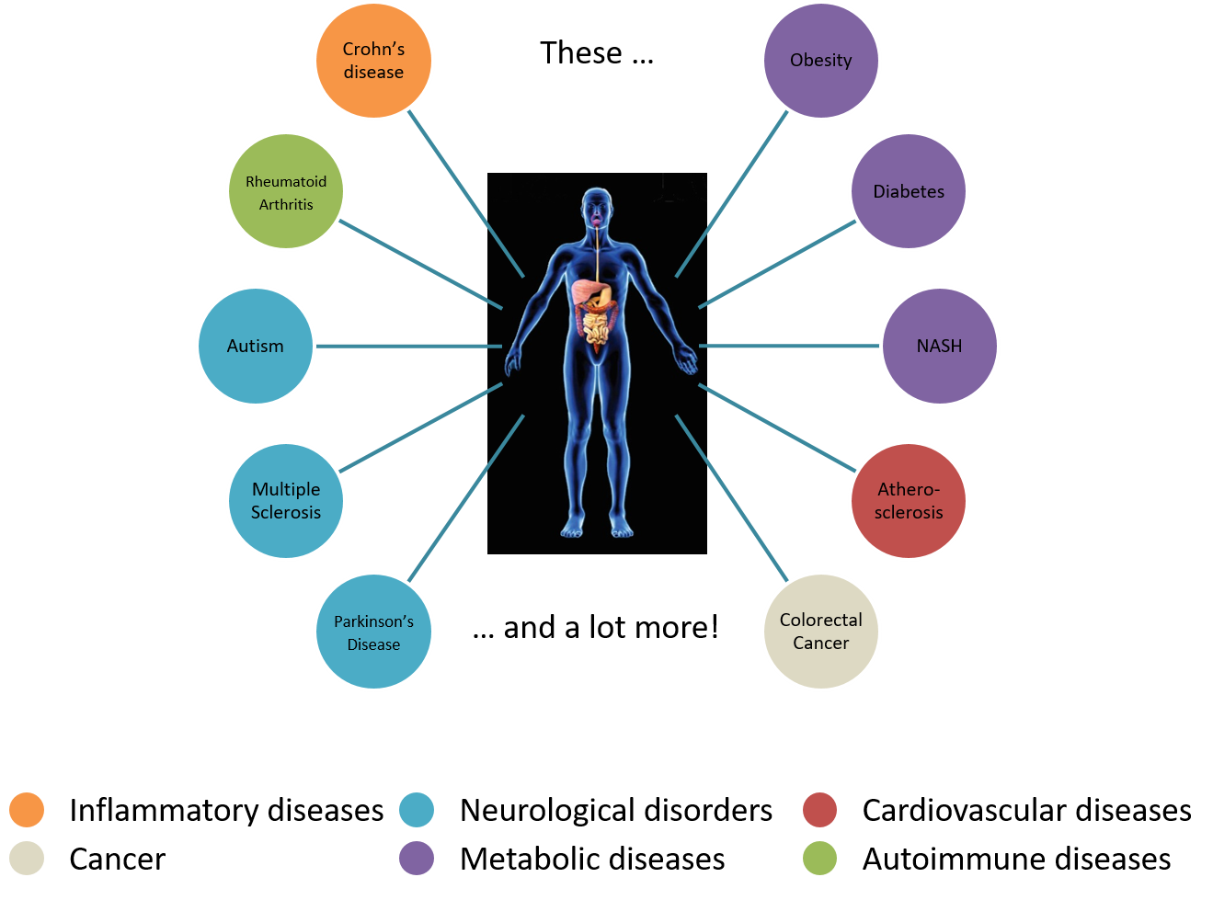
Gut microbiota are associated with diseases
But we do not know the molecular mechanisms behind these associations

Slide 5
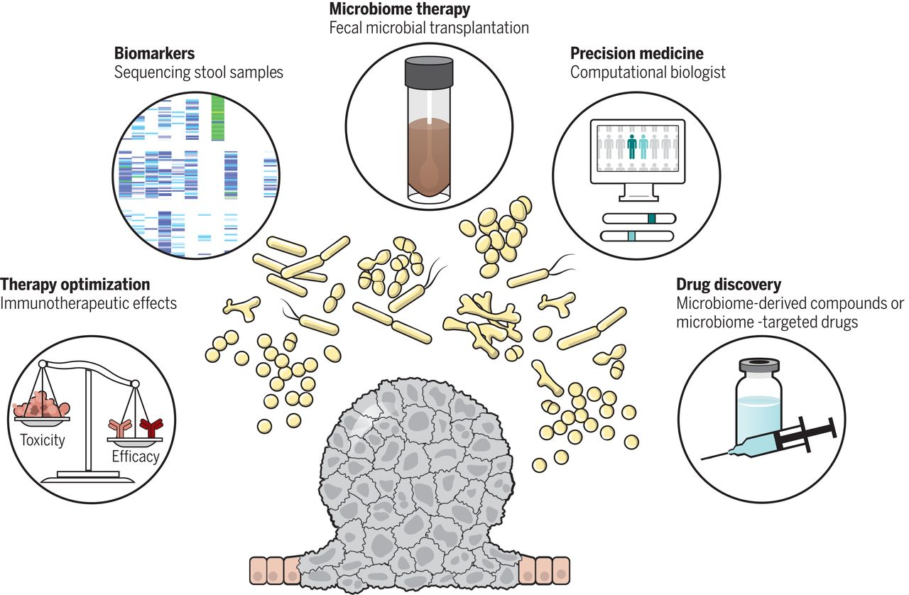
Microbiome for diagnostic and therapeutic tools in cancer
Zitvogel et al, Science 2018

Slide 6
Can we diagnose CRC using microbiome biomarkers?

Slide 7


We performed a metagenome-wide association study towards CRC diagnosis
 | CRC | Control
Subjects | 74 | 54
Median age | 67 | 62
Male / Female | 48 / 26 | 33 / 21
Shotgun fecal metagenomics
128 subjects from Hong Kong, China

Slide 8
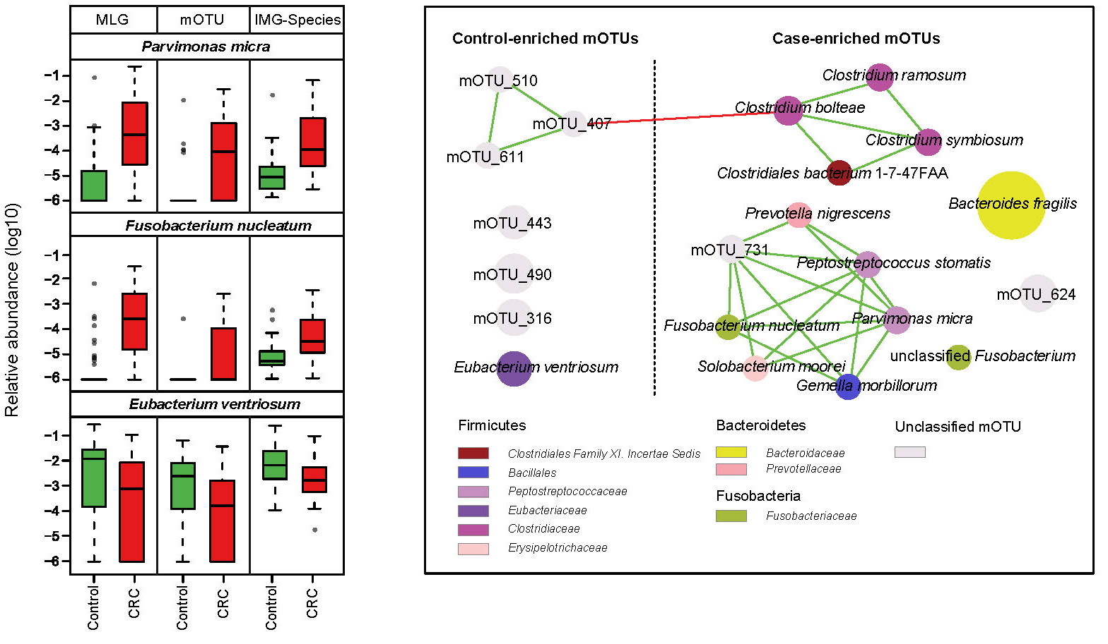
Dramatic changes in CRC patient fecal microbiota
Used 3 methods to be sure!
Yu et al, Gut 2017

Slide 9
Looking for CRC biomarkers in microbiome
Profiling
4.2 million gut microbial genes
Reduction
24,960 CRC-associated genes
Discovery
20 non-redundant biomarkers
2.1 million relevant genes
Association
Yu et al, Gut 2017

Slide 10
20 genes from gut microbiota as CRC biomarkers
}
Our study
Cool! Let’s diagnose cancer!
}
Qin et al, Nature 2012
}
Qin et al, Nature 2010
Combined log-abundance of 20 genes
Yu et al, Gut 2017

Slide 11
Validation by qPCR measurements
Randomly selected 4 / 20 genes
47 CRC patients and 109 controls from independent Chinese cohort
That did NOT work well!
Yu et al, Gut 2017

Slide 12
Can we improve with cross-cohort validations?
ethnic
Discovery
Chinese
Validation
Danish
Austrian
French
Consensus
All
CRC-enriched
Control-enriched

Slide 13
Towards point-of-care applications: 2 genes classify CRC
Area under ROC curve | = | 0.84
OR | = | 23 (5.8-90.8)
OR for stages I-II | = | 33 (4.5-248)
OR for stages III-IV | = | 15.8 (3.5-70.6)
Yu et al, Gut 2017

Slide 14
One biomarker enriched in TNM stage II and beyond
But we don’t dare to speculate more!
Yu et al, Gut 2017

Slide 15
In search of global CRC microbiome signatures

Slide 16





Meta-analysis of 5 CRC microbiome studies
 | Austrian Feng, 2015 | Chinese Yu, 2017 | French Zeller, 2015 | US Vogtmann, 2016
Control | 63 | 54 | 61 | 52
Carcinoma | 46 | 74 | 53 | 52
Total | 109 | 128 | 114 | 104
 | German unpublished
Control | 60
Carcinoma | 60
Total | 120

Slide 17
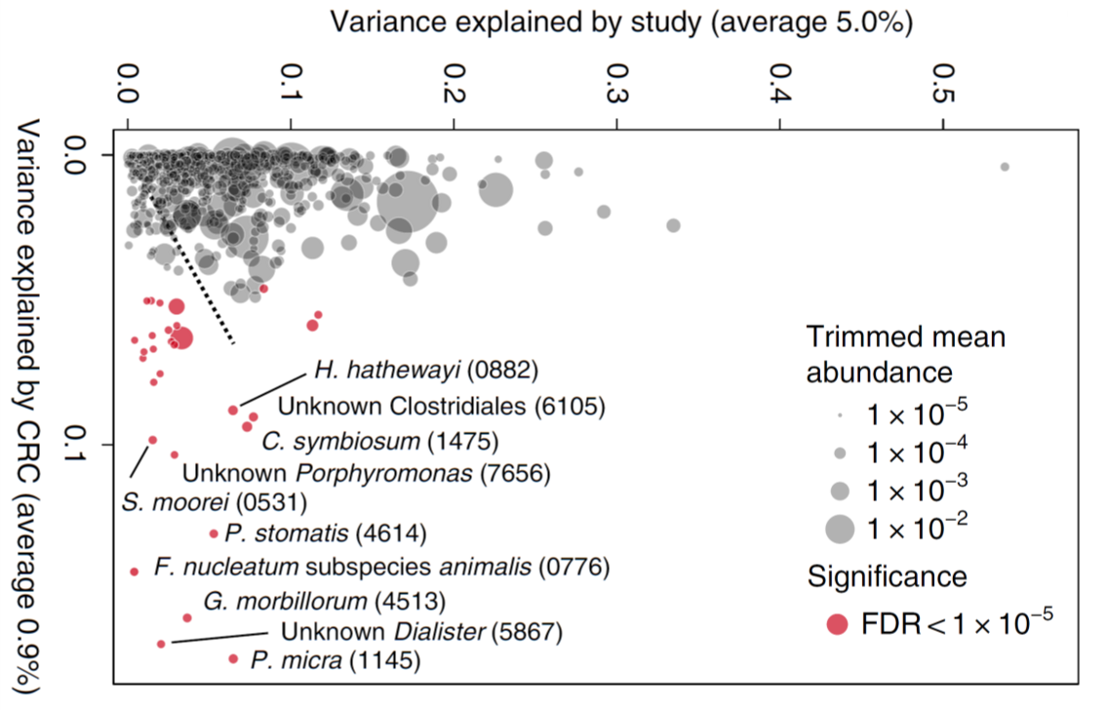
Strong batch effects in 5 cohorts, yet some true potential CRC biomarkers
Wirbel*, Pyl* et al, Nature medicine 2019

Slide 18
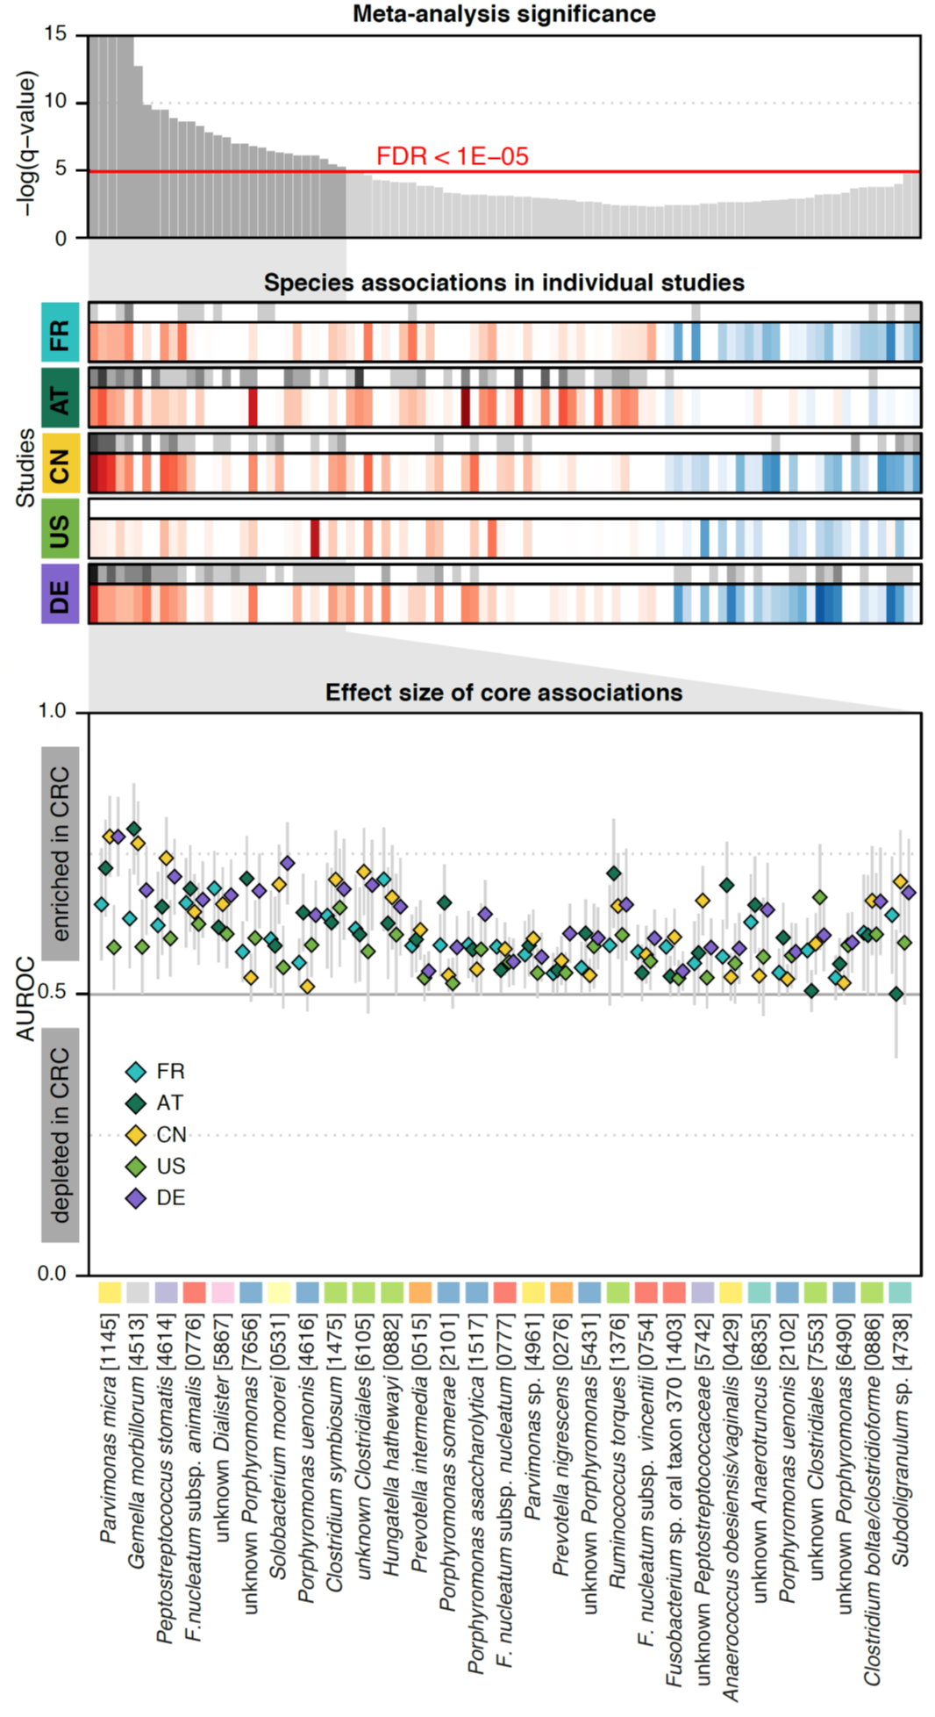
Several consistent CRC biomarkers across studies

Slide 19
Microbiome features can classify CRC in a transferable manner
Microbiome species
Area under ROC curves from LASSO models, including cross-validation.
Wirbel*, Pyl* et al, Nature medicine 2019

Slide 20
Training from multiple cohorts improves classification performance
Microbiome species
Wirbel*, Pyl* et al, Nature medicine 2019

Slide 21


Acknowledgments
Paul Pyl
Alireza Kashani
Albert Palleja
Peer Bork
Georg Zeller
Jakob Wirbel
Jun Yu (CUHK)
Jessie Liang
Liang Xiao
Qiang Feng
Karsten Kristiansen (U. Cph)
Lise Madsen (NIFES)
Jun Wang

Slide 22
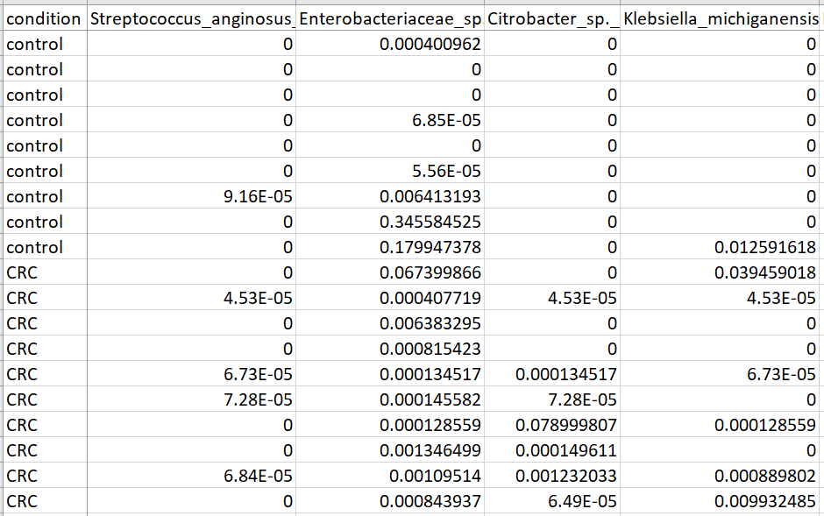
Hackathon: How does the data look?
8 cohorts (1 file per cohort)
Contains CRC and control samples
Each row is a sample
First column is the label
2nd column onwards is species abundance

Slide 23
Hackathon questions
Build a CRC classifier for each cohort
How does it compare with published classifier performance (diagonal values)?
Apply each classifier on other cohorts
How does it compare with published classifier performance (non-diagonal values)?
Identify CRC biomarker species

